Slide 1

FIFO UVM
Project report and
Certificate
By: Ahmed Alaa Mohamed

Slide 2


Slide 3
Table of content
Verification plan
UVM structure
RTL Code and bugs
Top module
TEST
Environment
Agent
Monitor
Driver
Configiration object
Sequencer
Sequence Item
Scoarboard
Coverage collector

Slide 4
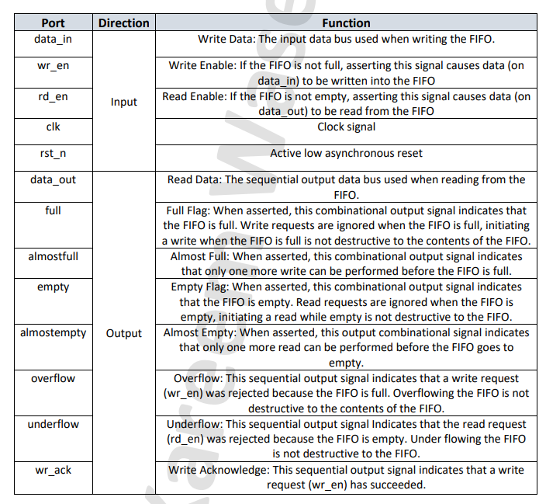

Synchronous FIFO
A Synchronous FIFO operates as a memory buffer that stores data in a first-in-first-out order. It uses a clock signal to synchronize read and write operations, allowing data to be written when space is available and read when data is present. The FIFO monitors its status through flags like "full" and "empty," which prevent overflows (writing when full) and underflows (reading when empty). Its design ensures efficient, sequential data handling in systems requiring controlled data flow between components operating at different speeds.

Slide 5
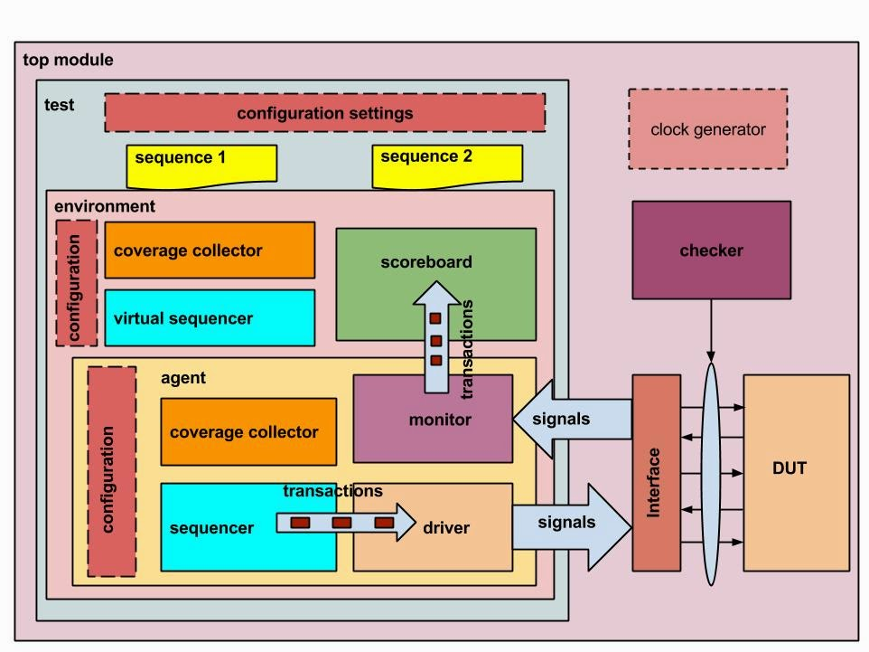
UVM Structure

Slide 6
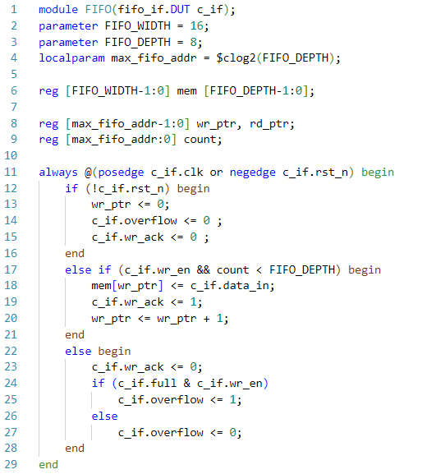
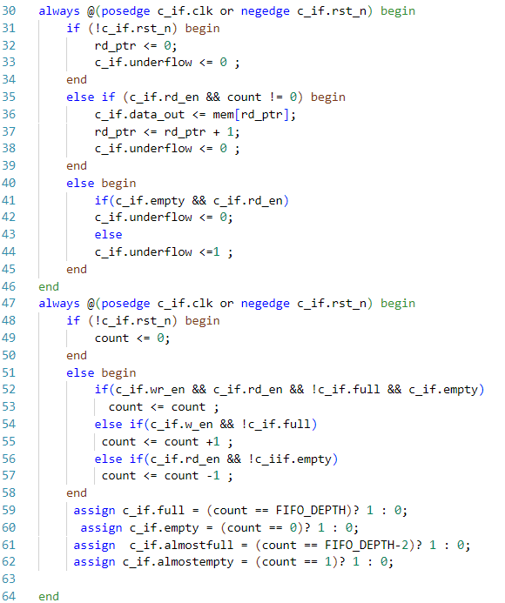
Design

Slide 7
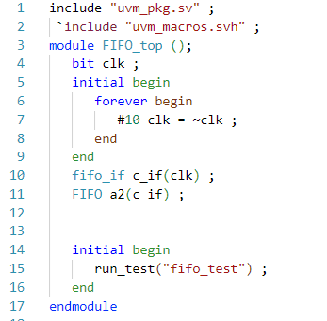
Top Module

Slide 8
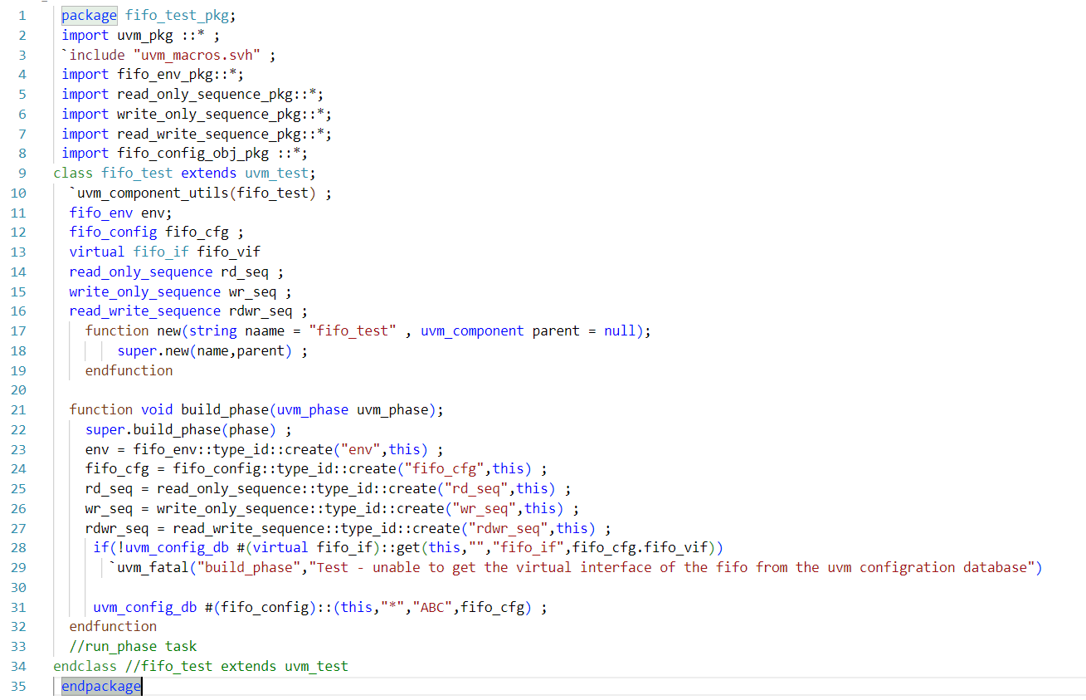
Test

Slide 9
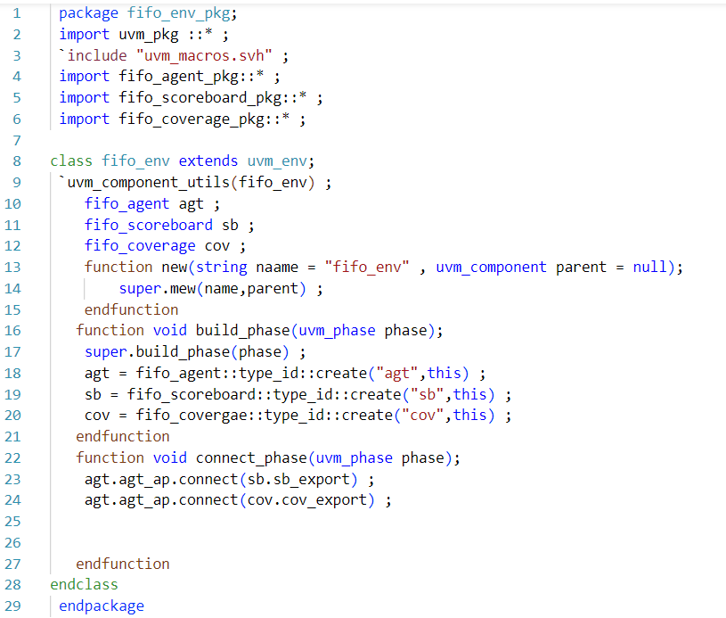
Environment

Slide 10
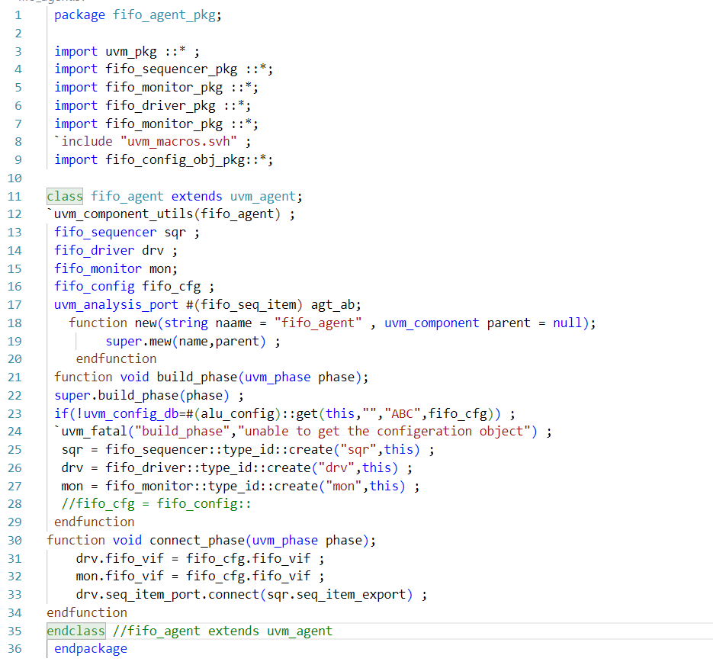
Agent

Slide 11
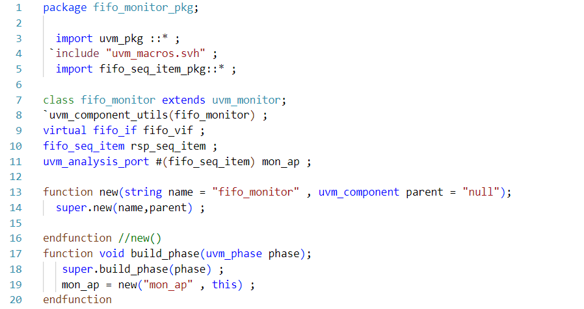
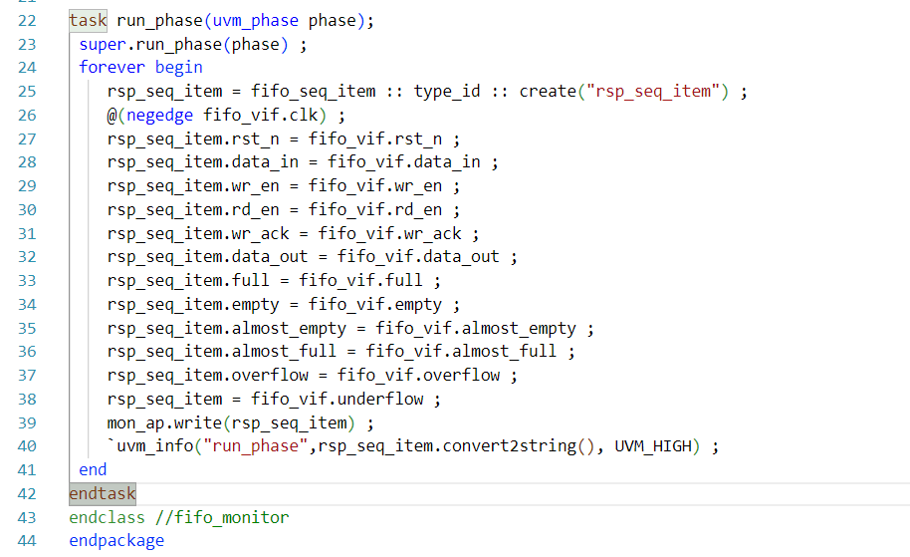
Monitor

Slide 12
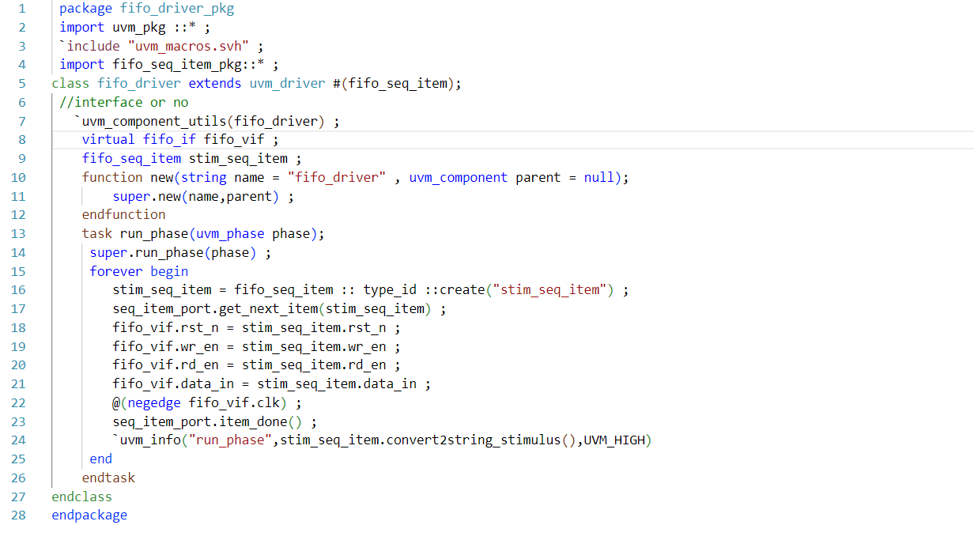
Driver

Slide 13
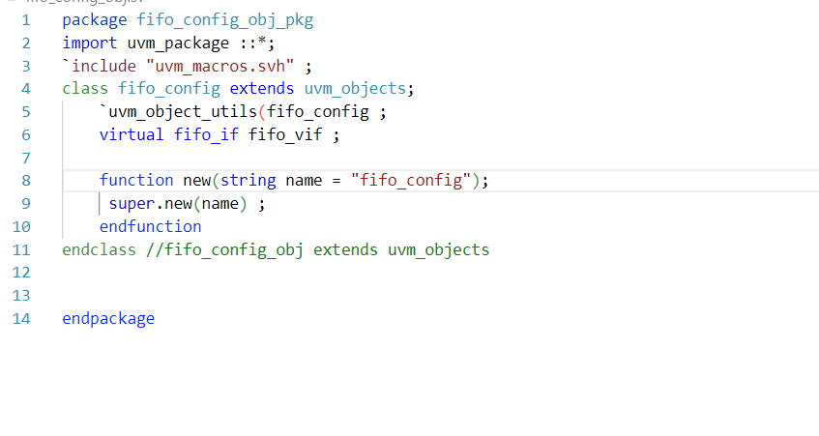
Configiration object

Slide 14
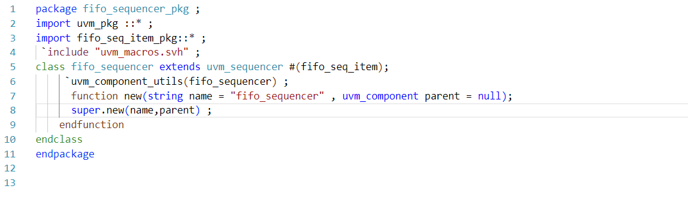
Sequencer

Slide 15
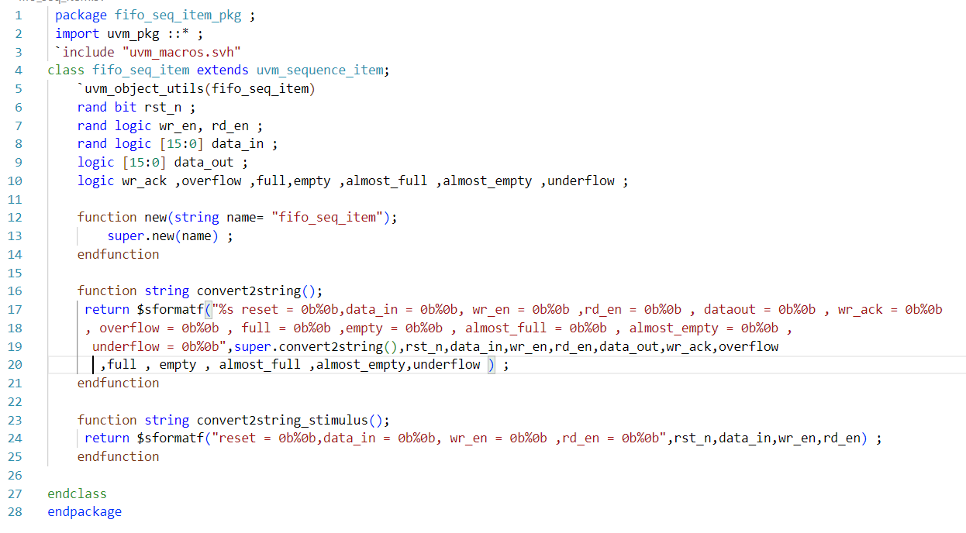
Sequence Item

Slide 16
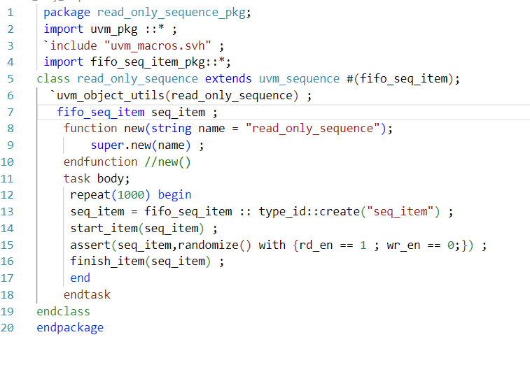
Read Only Sequence

Slide 17
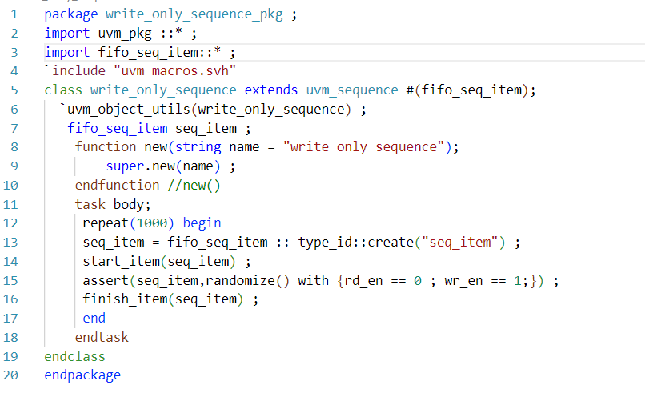
Write Only Sequence

Slide 18
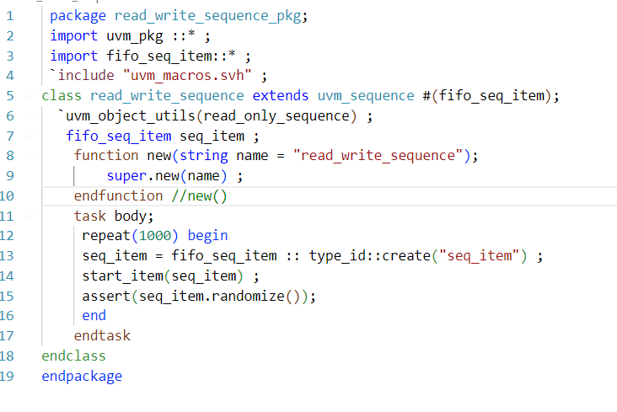
Read write sequence

Slide 19
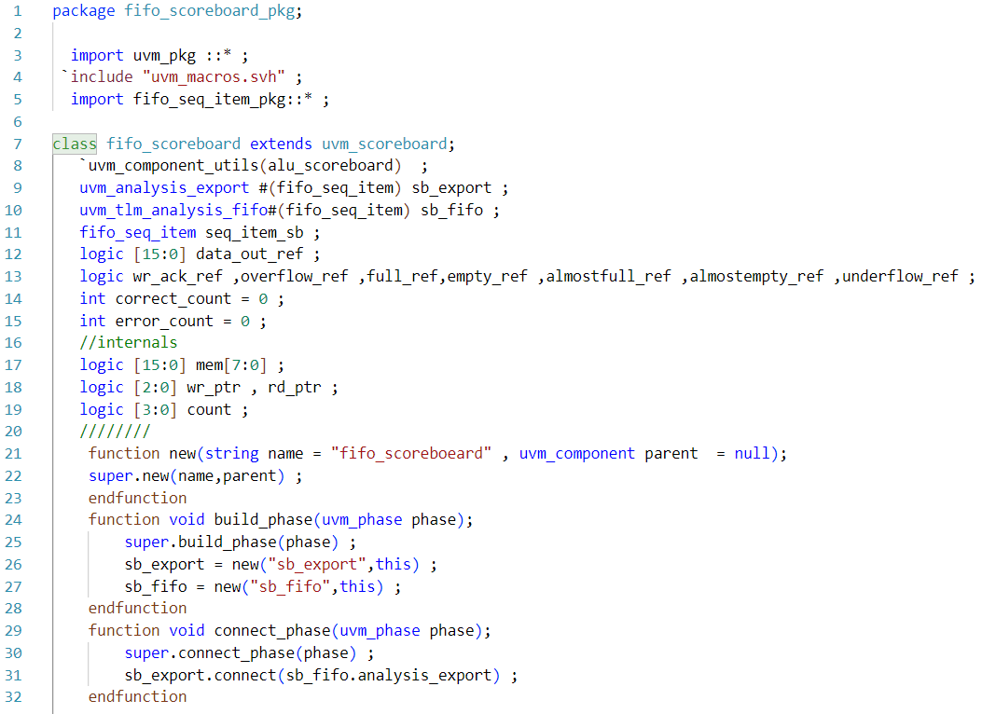
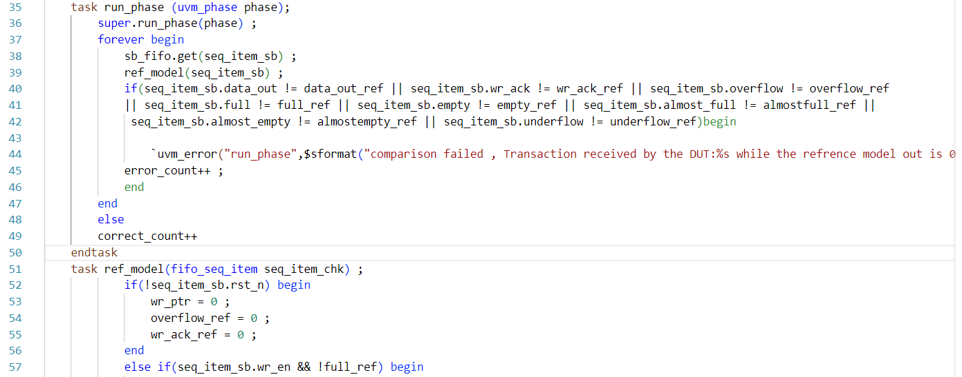
Scoreboard

Slide 20
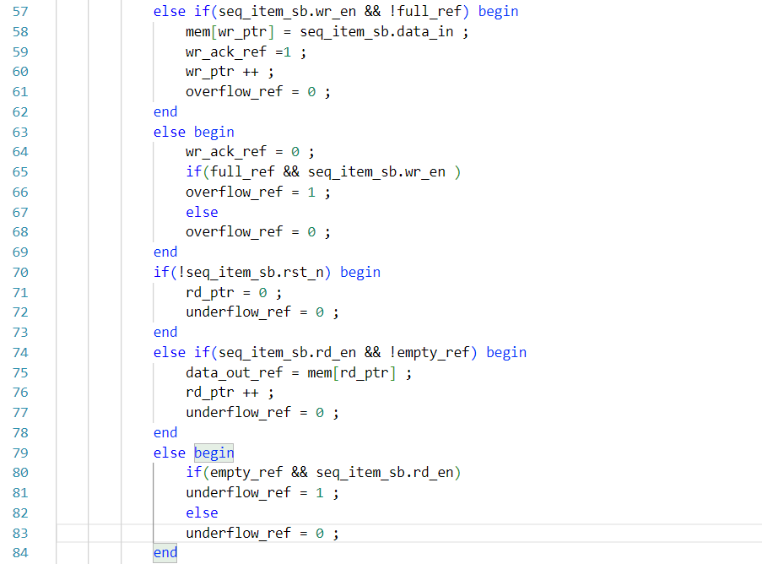
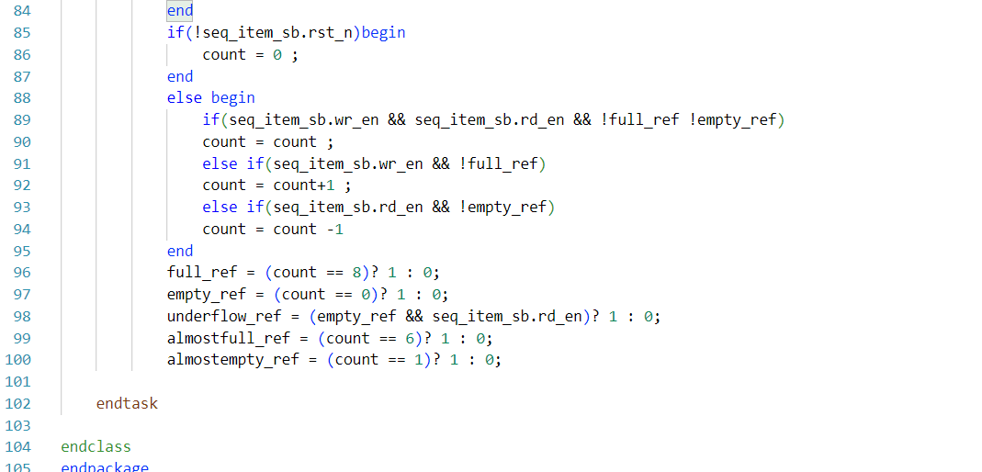
Scoreboard

